Slide 1
Safer Illinois App: Testing, Tracing, Access in the Face of COVID-19
Privacy Everywhere Conference
Friday, February 25, 2021
Presenters:
Edward Delaporte, Manager, Cybersecurity Software Development & Assurance, University of Illinois
Isaac J. Galvan, Senior Product Owner, University of Illinois
Keith Wessel, IAM Architect, University of Illinois

Slide 2
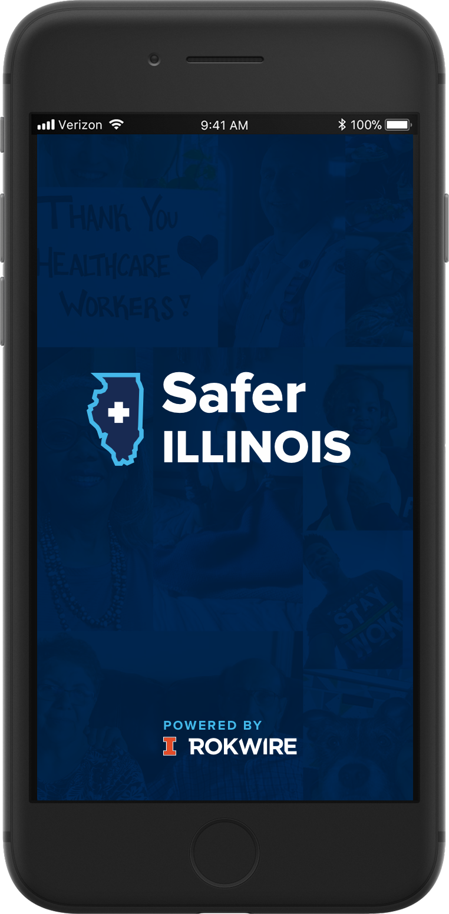
The Safer Illinois Story
March 2020: Moved to online instruction and remote work
July 2020: Rapid on-campus COVID-19 testing available
August 2020: Safer Illinois app launches

Slide 3
ROKWIRE Platform
Massive collaboration of many colleges and units
Open-source mobile software platform
Designed to rapidly integrate new functionality and data sources without starting from scratch each time
Aims to dramatically lower the cost of digital services
Privacy-first architecture and governance
Smart, Healthy Communities
Debuted with the Illinois App in 2018

Slide 4
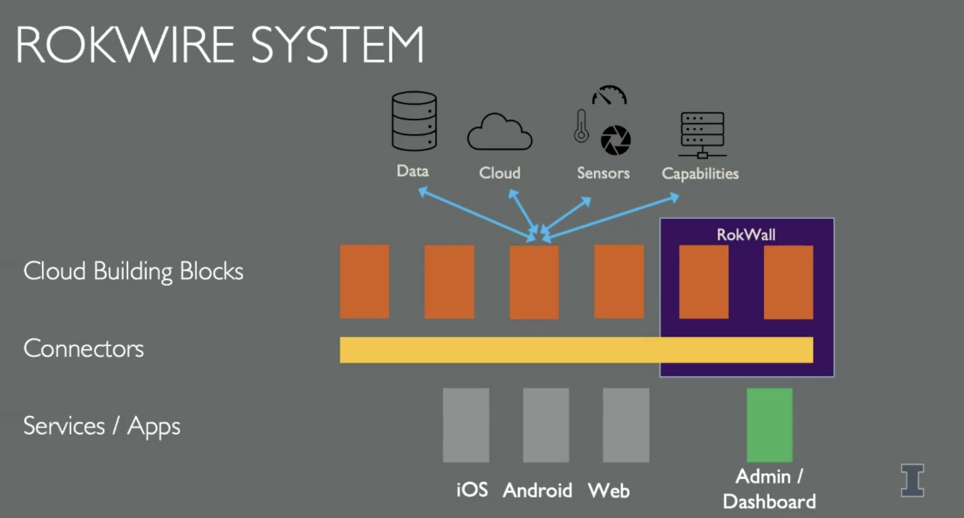
Notes:
The goal was to lower cost of deploying

Slide 5

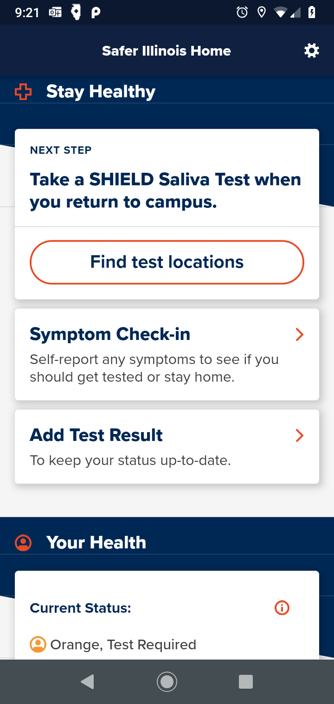
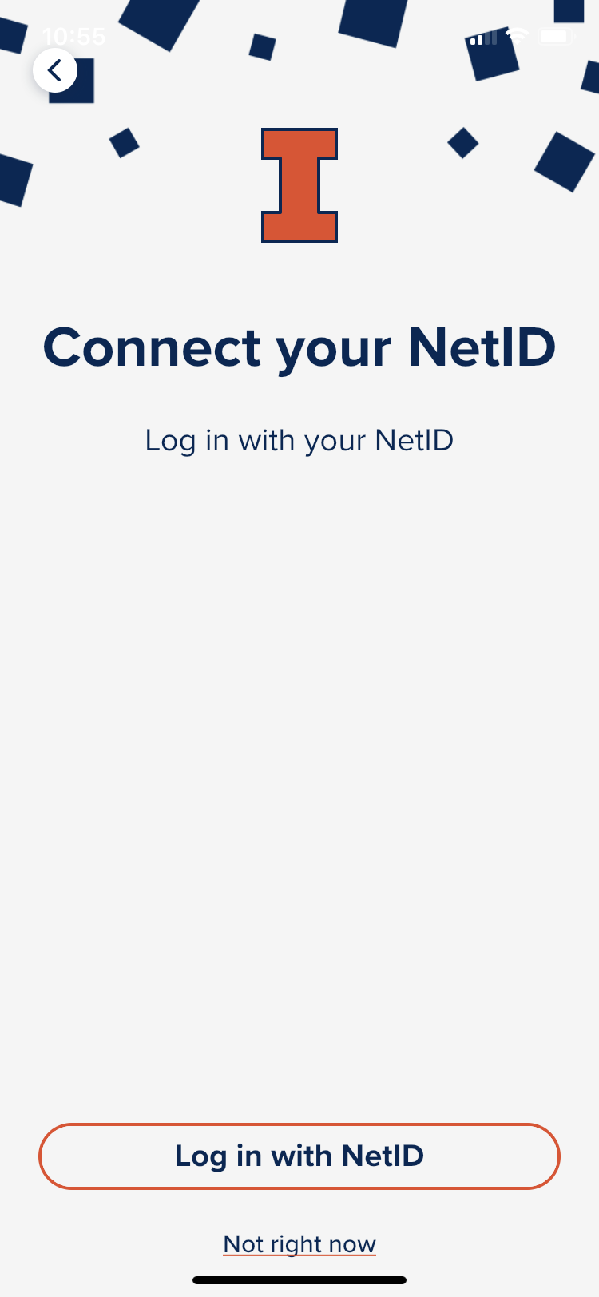
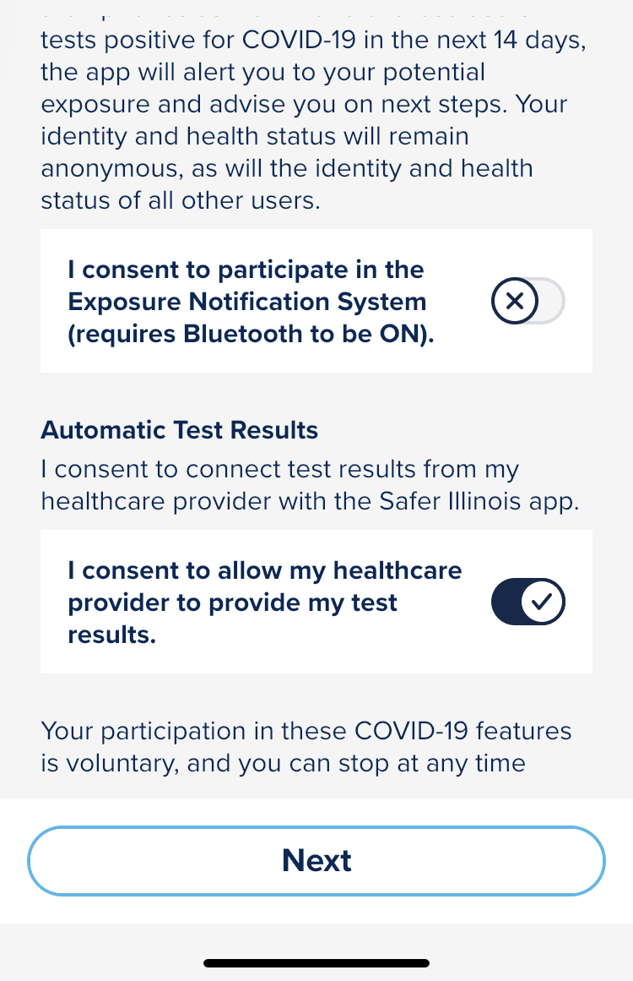
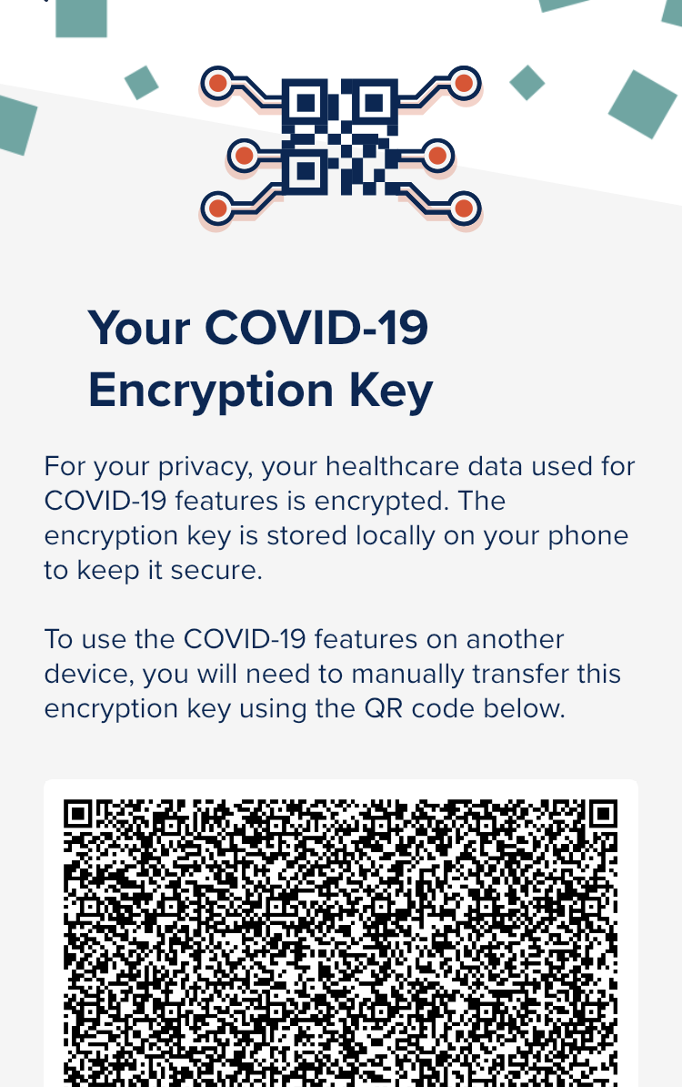
First-time Setup

Slide 6
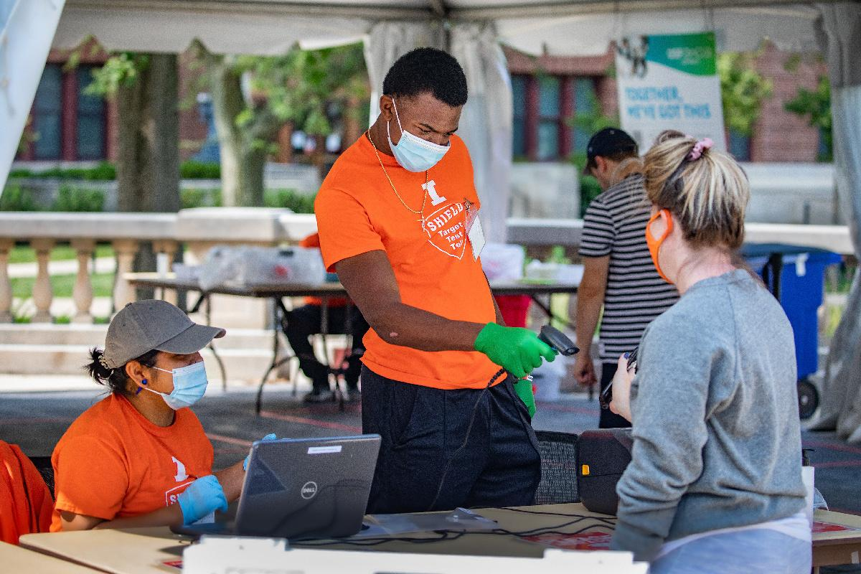
Checking In

Slide 7
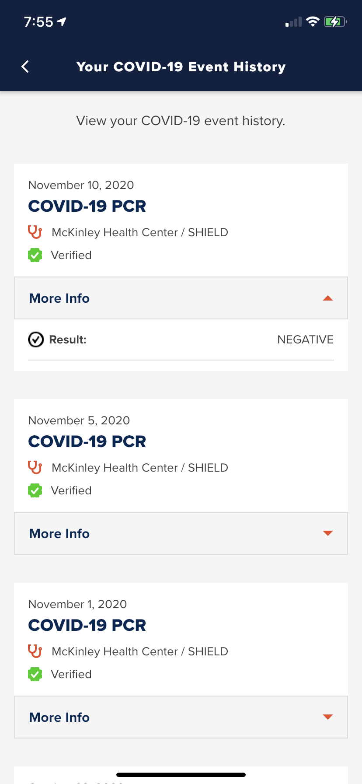
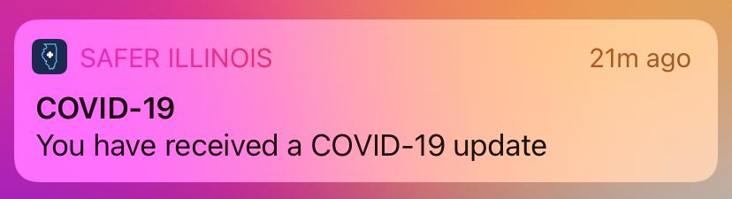
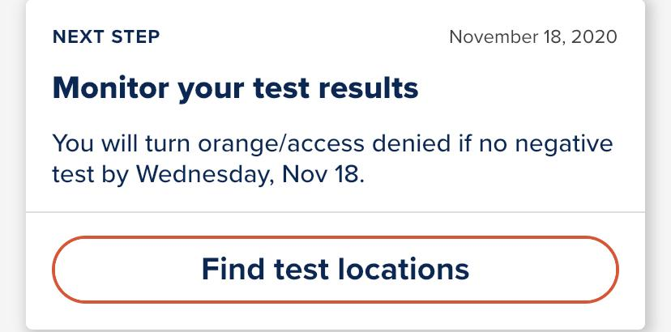
Getting Your Results

Slide 8
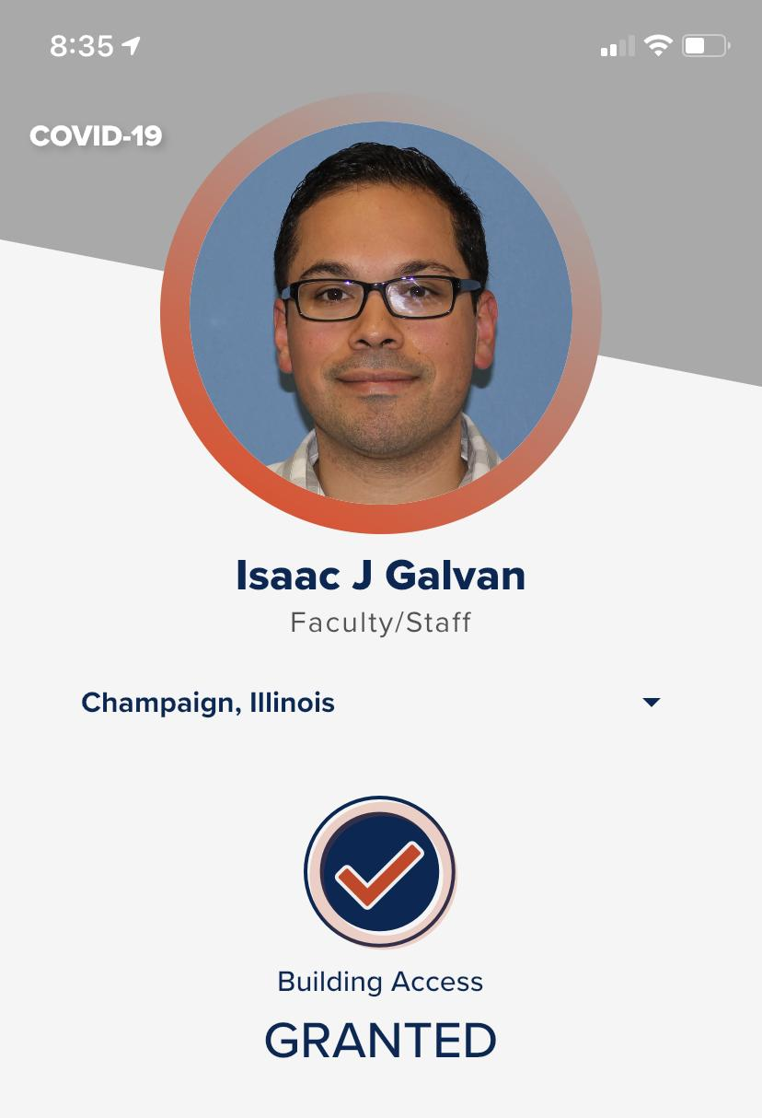
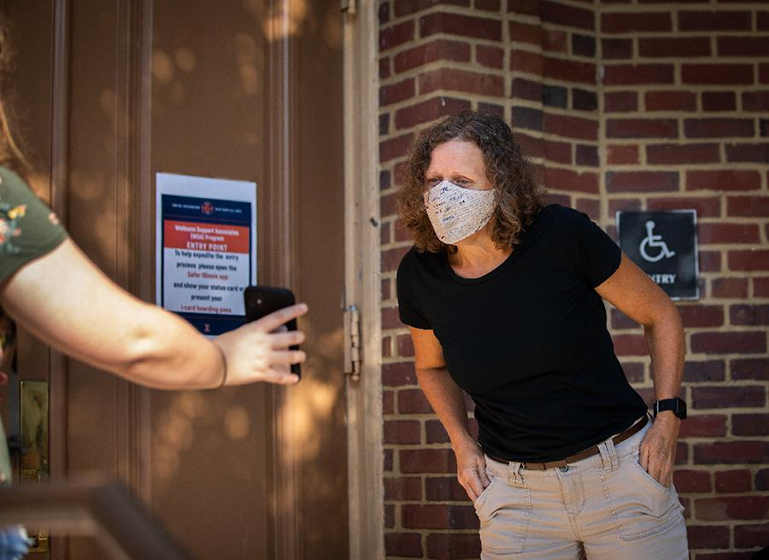
Building Access
Notes:
Wellness Support Associates verify that students and staff entering campus buildings have appropriate entry status, making sure individual are up-to-date with on-campus testing, do not have a positive COVID-19 test or have not been instructed by the Champaign-Urbana Public Health District to quarantine or isolate for any reason.

Slide 9
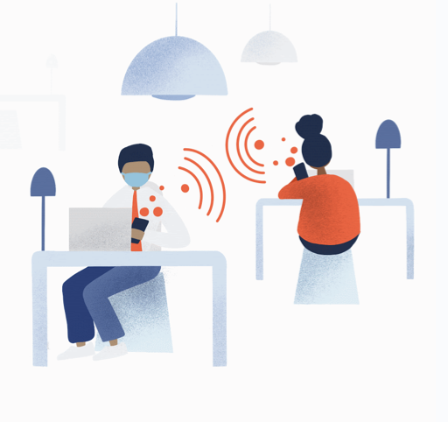
Exposure Notification System
Privacy-preserving Bluetooth exposure notification system developed at Illinois. Completely voluntary and tuned for effectiveness.

Slide 10
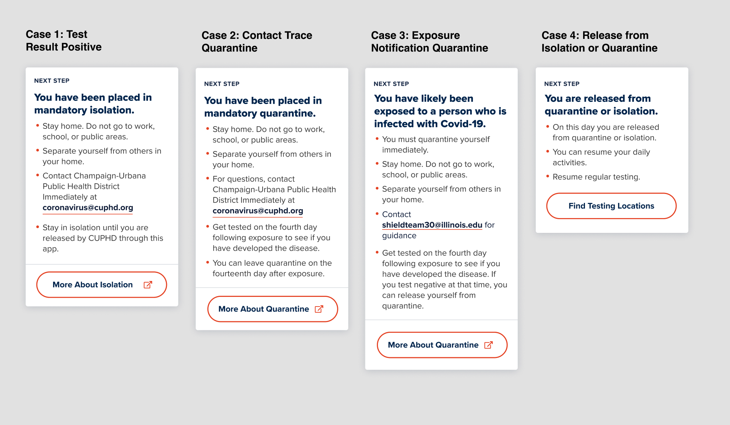
Quarantine and Isolation Support

Slide 11
Authentication
It's Shibboleth!
Put the Shibboleth OIDC extension in production August of 2019
Had to make a few adjustments for these clients
Increased refresh token lifetime
Releasing some values of isMemberOf manually
New features coming in IdP will help to simplify these tasks
Users see the usual MFA and consent UI that they're used to

Slide 12
Authorization
Grouper saves the day
We've run Grouper since late 2019
Running in AWS using I2 Trusted Access Platform
App owners have their own folder
Groups in that folder are synced to Active Directory
Shibboleth releases any group memberships with the given prefix to the app

Slide 13
Agility in Cybersecurity
Challenges / Victories
Abrupt transition to fully remote in March 2020
Minimum Viable Product released for the Fall Semester
Solid Foundation - Before 2020
Talented people working hard.
Rokwire - Community oriented agile open source framework
Rokwall - Privacy oriented research team supporting Rokwire
University of Illinois Cybersecurity Investment
Existing Agile SDLC centered on the GitHub platform
Notes:
Timing plan: 10 minutes IG - 5 - KW - 5 ED - 10 IG - 30 Q&A
TimeLine Review
March 2020 - Remote
July 2020 - On campus testing
August 2020 - Safer Illinois App released
Things that were not built in flight.

Slide 14
Agility in Cybersecurity
Rokwire/Rokwall Architecture
Containers
Microservices
Secure Cloud Computing Enclaves
Privacy Centric Design from Day One
From Hot Dog Delivery
To COVID Response

Slide 15
Privacy-first
Health data is encrypted, only key is on your phone
Easy to understand Privacy Policy
Data privacy committee and several reviews from campus
Remove your data anytime

Slide 16
Safer Illinois: Just one piece of the puzzle
SHIELD: Target, Test, and Tell
SHIELD Team 30
Student Affairs and Housing

Slide 17
Lessons Learned
Privacy first
Test your messaging with real users
App store approvals can be lengthy
Expect questions at launch, lots of them
Not all users have smartphones
Remain flexible as the situation updates
Different rules for different groups, from as large as “all undergraduates” to as small as a single residence
Notes:
Faculty staff numbers are increasing now in CU. Flexible rules engine allows us to target specific groups.

Slide 18
What’s next?
More detailed testing plans for Spring return
Community testing
Expanding to other communities and campuses via ROKMETRO

Slide 19
Resources
Safer Illinois Website
University of Illinois COVID-19 website
COVID-19 Testing Dashboard
COV-Course: 08. Data Security and Privacy
William Sullivan and Sanjay Patel go in-depth
University of Illinois YouTube
Safer Illinois on Github
Rising to the Challenge podcast

Slide 20
Questions & Answers

